Slide 1






UK Train Rides Dashboard
DEPI3 - Data Analysis Power Bi

Slide 2
Team Members
Amr Essam Fathy
Ahmed Essam Eldin Abd El Fattah
Ahmed Ibrahim Abdelhamid
Reham Mahmoud Moustafa Shaarawy
Eslam Mohamed Abd El Fattah

Slide 3

TABLE OF CONTENTS
Team Members
01
04
Steps
Project Overview
02
05
Data Cleaning & Modeling
Data Description
03
06
Insights & Visual

Slide 4
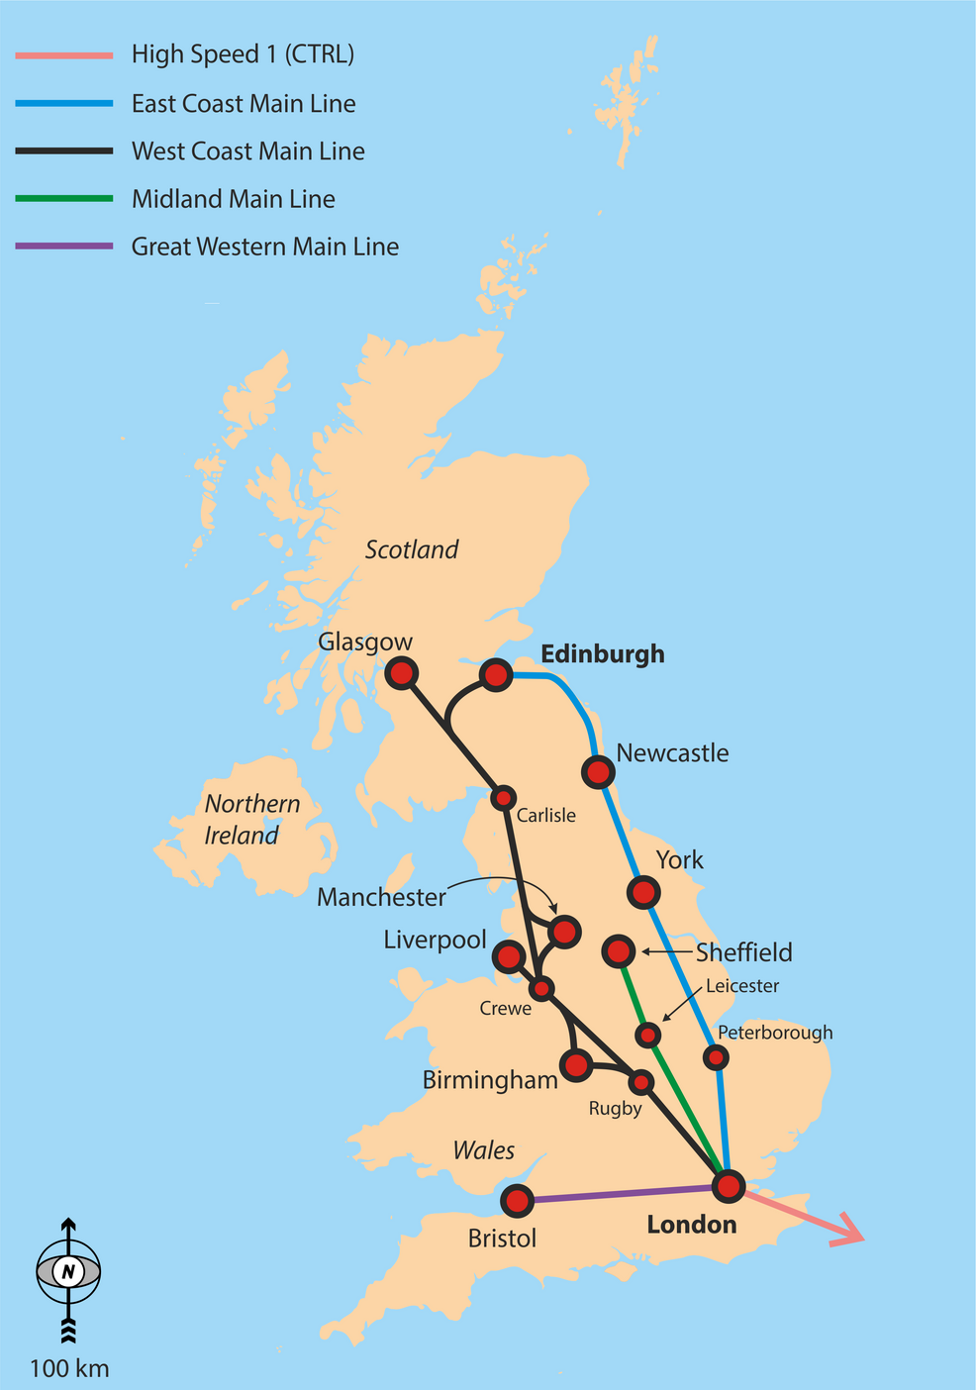

Project Overview
Our project focuses on analysis of UK railway operations from January to April 2024 using Power BI. Our goal is to provide key insights to improve service performance and increase passenger satisfaction.

Slide 5
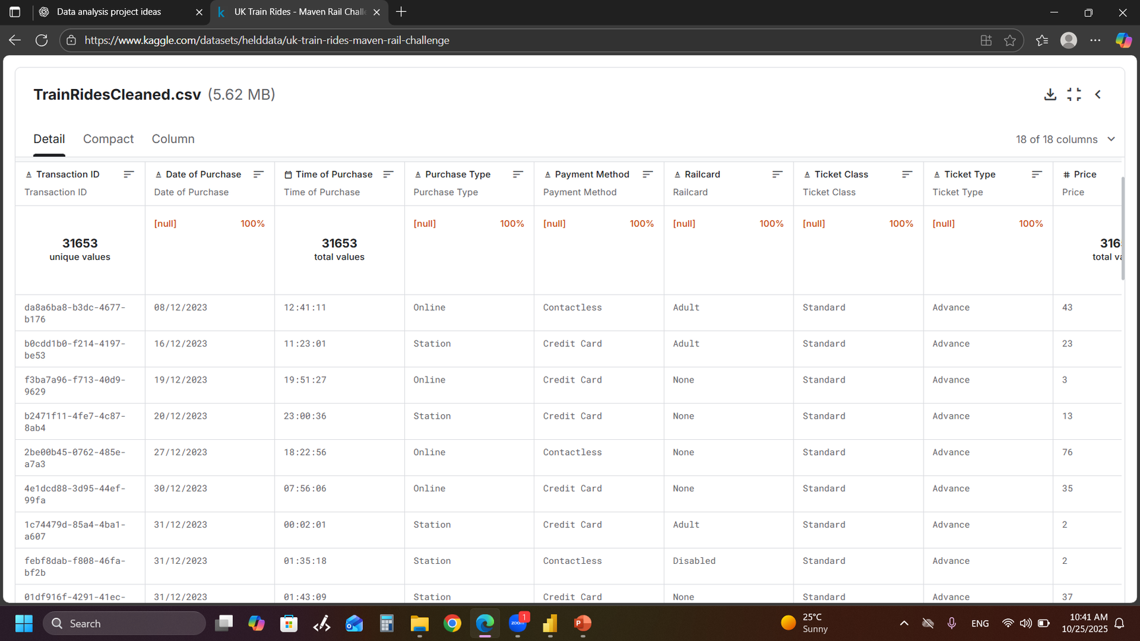
Data Description
- The original dataset is CSV file which consists of 18 columns that simulates train ride records across the UK rail network from January to April 2024.
- This dataset contains ticket pricing and availability data for UK National Rail services. It includes details about train journeys between UK stations, fare types, and ticket prices.

Slide 6
Analysis Steps
Cleaning
Transformation
Modeling
Dax
Insights
Visuals
Dashboard & Reports

Slide 7
Data Cleaning

Slide 8
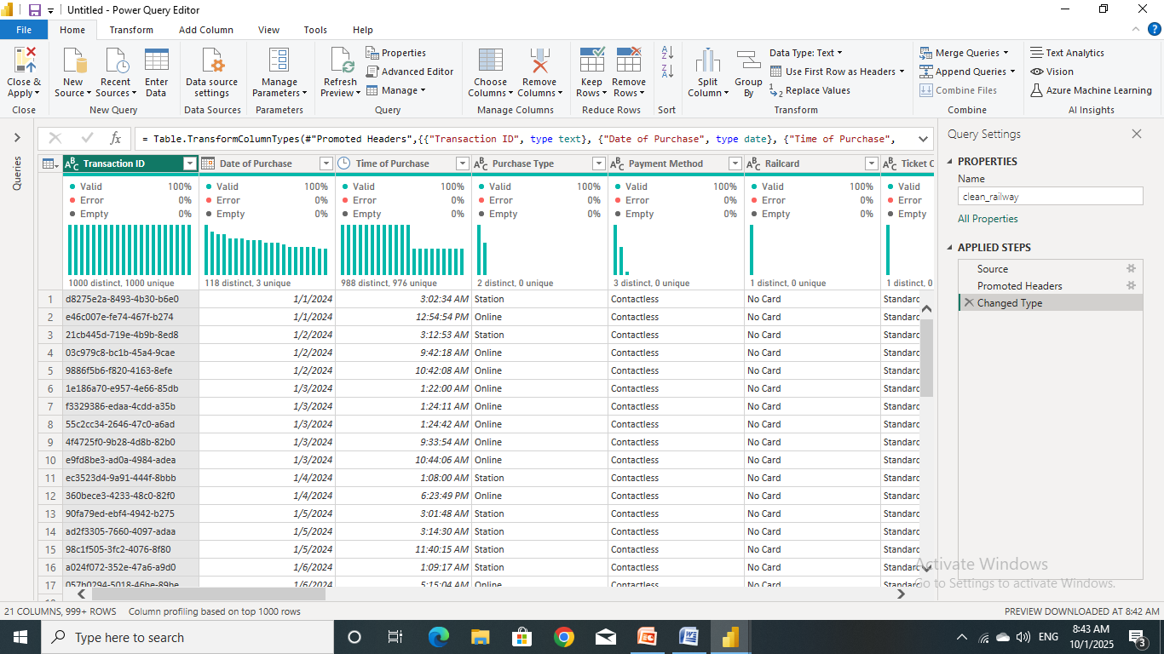
Power Query Editor (Before Cleaning)

Slide 9
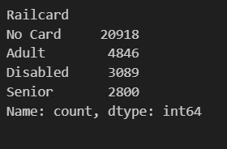
Rail Card:
Replace “None” with “No Card”.
Replace blank with “No Card”..

Slide 10
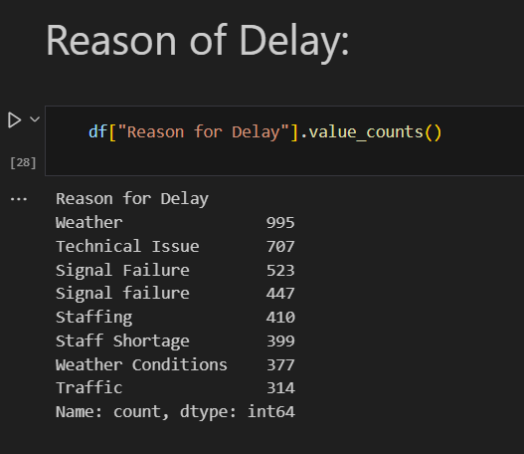
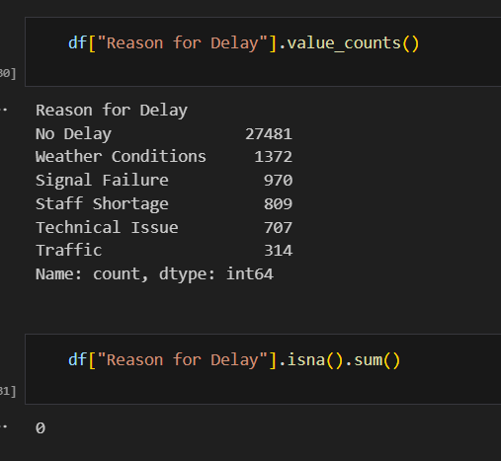

Reason for Delay:
Replace “Weather” with “Weather Conditions”.
Replace “Staffing” with “Staffing shortage”.
Replace “Signal failure” with “Signal Failure”.

Slide 11
Transformation

Slide 12
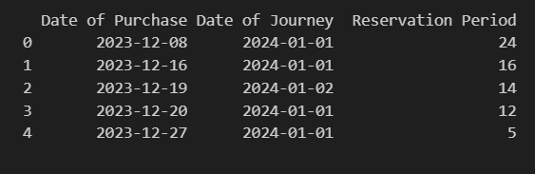
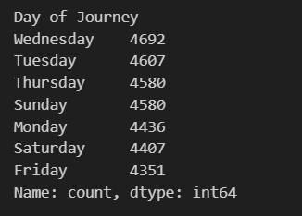
Transformation
Calculate Reservation period from Date of Purchase and Date of Journey.
Calculate Day of Journey from Date of Journey.
Calculate Delay in Minutes from Arrival Time and Actual Arrival Time.

Slide 13
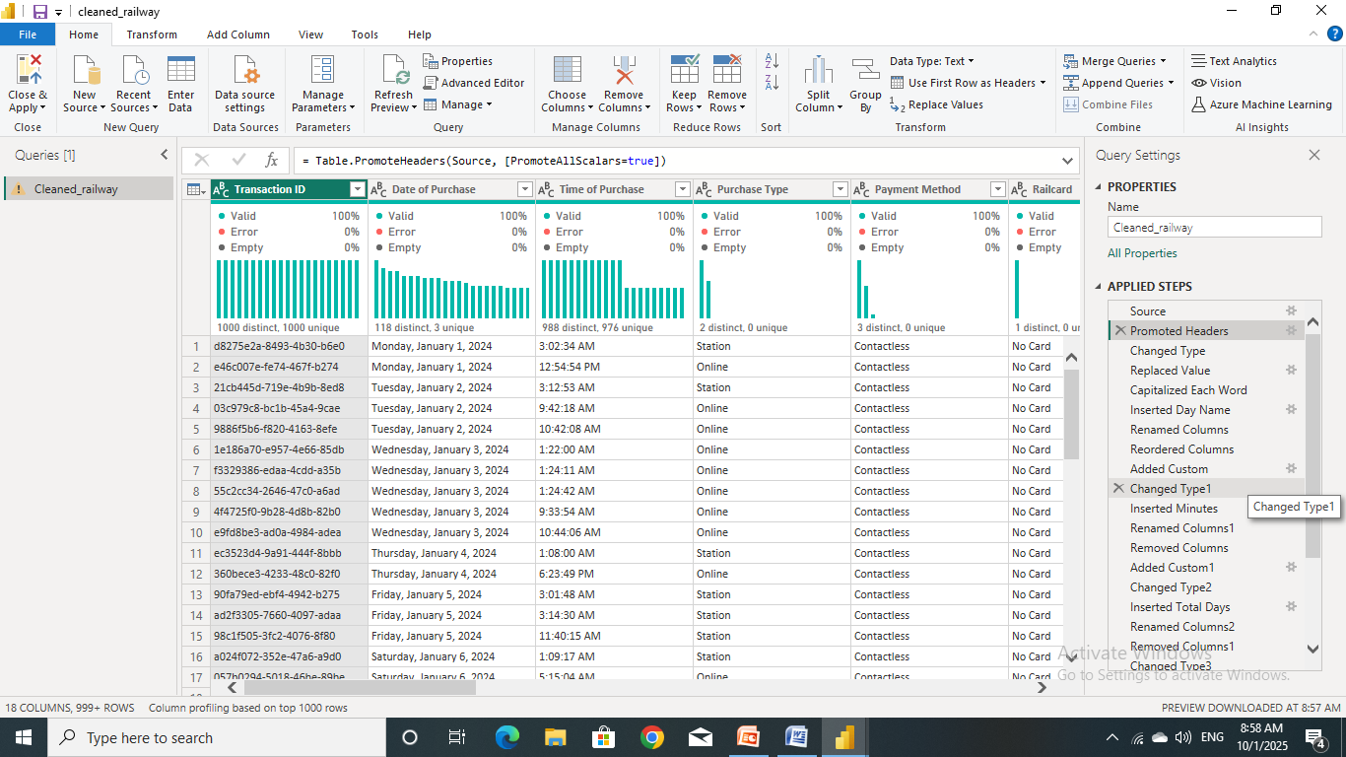
Data Cleaning
Power Query Editor (After Cleaning)

Slide 14
Data Modeling

Slide 15
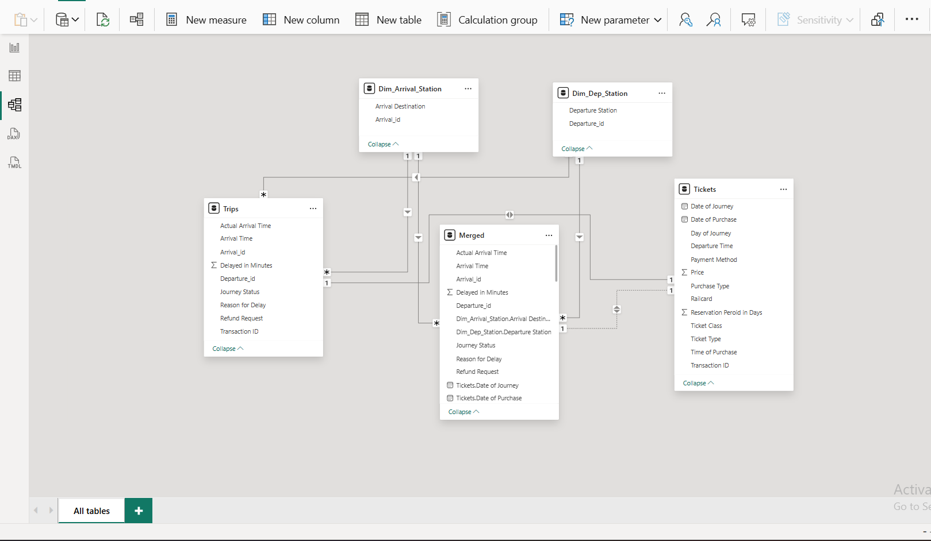
Data Modeling

Slide 16
Dax

Slide 17
DAX
Examples of Added Measures:
Total Trip = COUNT(Cleaned_railway[Transaction ID])
on_time_trip = CALCULATE([Total Trip],Cleaned_railway[Journey Status]="ON Time")
Delayed_trip = CALCULATE([Total Trip],Cleaned_railway[Journey Status]="Delayed")
Cancelled_trip = CALCULATE([Total Trip],Cleaned_railway[Journey Status]="Cancelled")
Delay_percentage = [Delayed_trip]/[Total Trip]*100
on_time_percentage = [on_time_trip]/[Total Trip]*100
Cancelled_percentage = [Cancelled_trip]/[Total Trip]*100

Slide 18
DAX
Examples of Added Measures:
avg_delay_duration = AVERAGE(Cleaned_railway[Delayed in Minutes])
max_delay_duration = MAX(Cleaned_railway[Delayed in Minutes])
min_delay_duration = MIN(Cleaned_railway[Delayed in Minutes])
total_revenue = SUM(Cleaned_railway[Price])
avg_price = AVERAGE(Cleaned_railway[Price])
max_price = MAX(Cleaned_railway[Price])
min_price = MIN(Cleaned_railway[Price])

Slide 19
Insights

Slide 20
Insights
Ticket Sales
Total tickets sold
Weekly trend of ticket purchases
Total revenue
Average ticket price by type
Average ticket price by class
Passenger
How do people buy tickets? (app, online, station)
How do they pay? (cash, card, e-wallet)
Passengers by ticket type
Passengers by class (first, economy, etc.)
Average time between booking and travel

Slide 21
Insights
Station and routes
Total number of routes
Most popular routes
Busiest travel days
Busiest travel hours
Performance
Trips on time, delayed, or cancelled
Reasons for delays and cancellations
Average delay time
Percentage and amount of refund requests

Slide 22
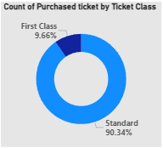
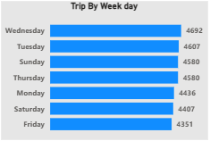
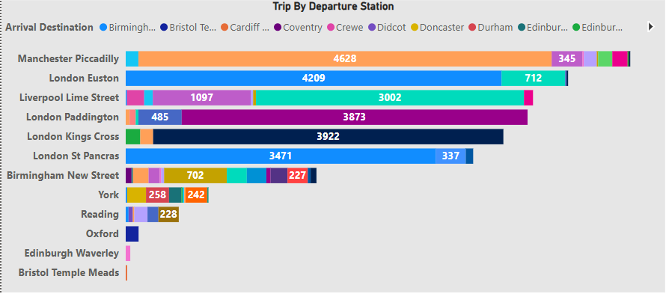
Visuals

Slide 23
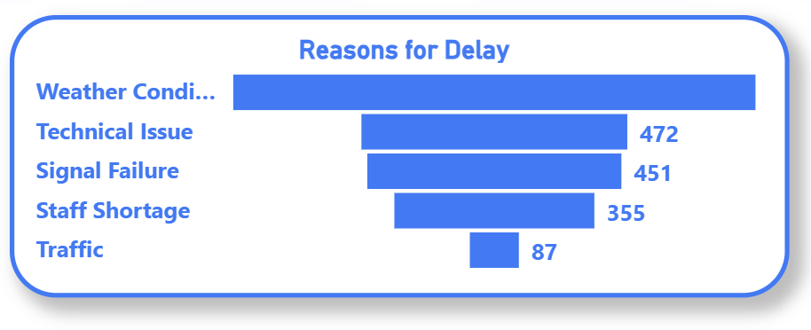
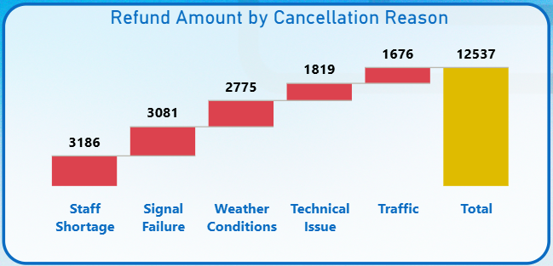
Funnel Shape Shows Reasons For Delay
how different cancellation reasons contribute to the total refund amount, with staff shortage and signal failure having the highest impact.

Slide 24
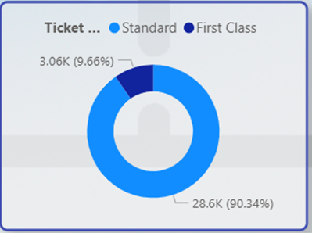
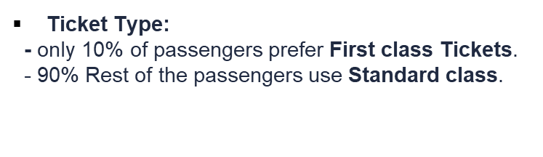
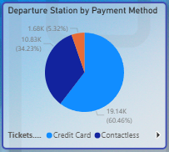
Payment Method
60% of tickets paid by credit card
15% is a cotactless

Slide 25


Microsoft Power BI

